Slide 1
Hiring Manager Interview and Job Offer
Yuliya Savyuk & Yuriy Havryliv
2015

Slide 2
Plan
Theory
What is HMI? What parts it consists of and the goal of HMI?
When and why it should be held?
Who is the Participants?
Recruiter’s Role Before During and After Interview.
Salary Negotiation
Practice
Presenting HR Feedback and all the needed information for HM.
Conducting Hiring Manager Interview
Theory&Practice
Job Offer Delivery
Job Offer Acceptance, Job Offer Rejection (During Different Stages)
Notes:
Yuliya

Slide 3
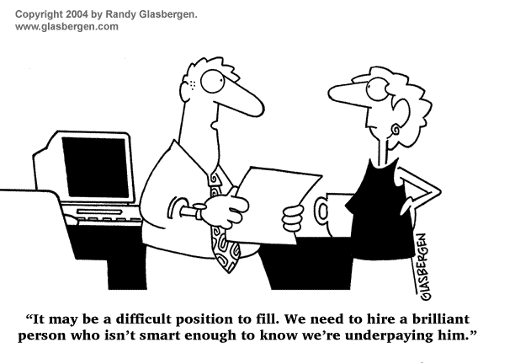

Slide 4
What is HMI?
It is one of the final stages of interviewing process, following Technical Interview, and can be conducted before Customer Interview or exactly before making the offer.
Introduction
Selling Part
Discussion/HM questions
Making Offer
Notes:
Yura

Slide 5
HMI Goal
To introduce candidate to Hiring Manager
To finalize selling process
To answer all the candidate’s questions (Company, Project, employment conditions, technologies)
To prepare for Customer interview if it supposes to happen
To make a decision on final offer and/or to make an offer
Notes:
Yura

Slide 6
HMI Participants
Hiring Manager (those could be Project Manager, Customer Manager, Delivery Manager) – depends on the company
Recruiter
Additional participants if needed:
Project Team Lead
Software Engineer from the team candidate is considered for
Notes:
Yura

Slide 7
Recruiter’s Role before HMI
Candidate’s Preparation/Managing candidate’s expectations
Feedback gathering and preparation (Technical, HR):
Doublecheck:
Salary expectations
Time to start
Any special requests from candidate
Communication with Hiring Manager
Choosing the candidate with the highest passing ability
Notes:
Yuliya

Slide 8
Recruiter’s Role During HMI
Moderating and leading the process during the interview
Preparing and making job offer
Notes:
Yuliya

Slide 9
Recruiter’s Role After HMI
Work with candidate’s questions and concerns
Communicate to Hiring Manager any issues
Making sure Job Offer is accepted
Notes:
Yuliya

Slide 10
Practice

Slide 11
Job Offer
Recruiter is responsible for delivering JO
Things to check:
Time to start
Bonuses, Relocation
Probation Period
Salary Negotiation
Salary review/Promotion Plan
Time to make a decision

